Slide 1

FINAL PROJECT Menganalisa pekerjaan dalam bidang data yang paling banyak diminati di negara Amerika dan Eropa
Anasthasia Suci

Slide 2
Table of Content
DATA SET
DATA PREPROCESSING
visualiZATION

Slide 3

Table of Content
MACHINE LEARNING.
MODEL EVALUATION.
INSIGHT&RECOMENDATION
DATA ANALISIS

Slide 4
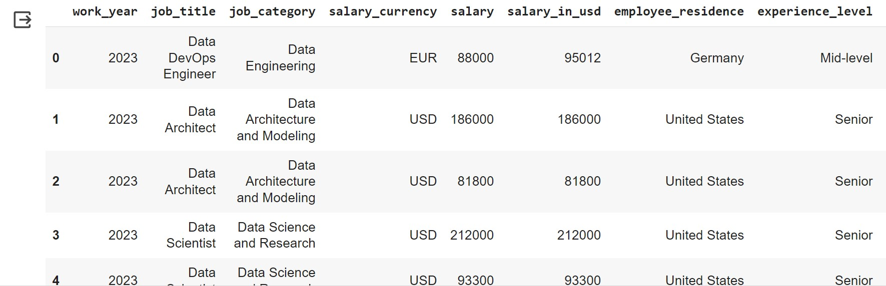
DATA SET
https://www.kaggle.com/datasets/hummaamqaasim/jobs-in-data/data

Slide 5
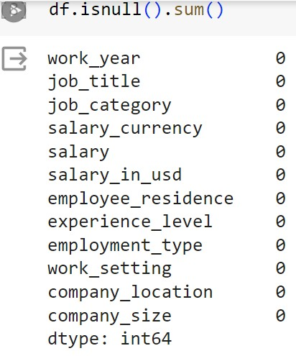
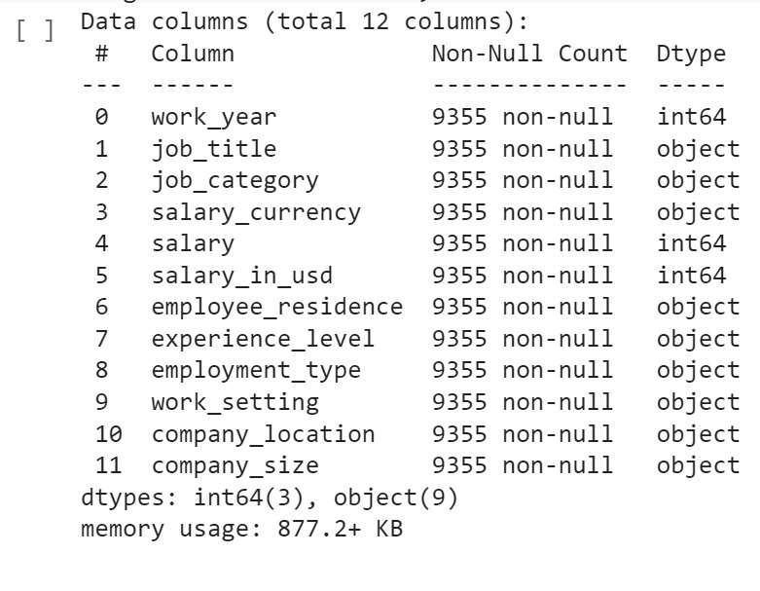
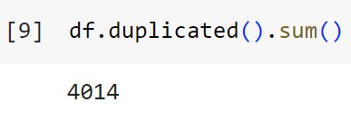
DATA PREPROCESSING

Slide 6
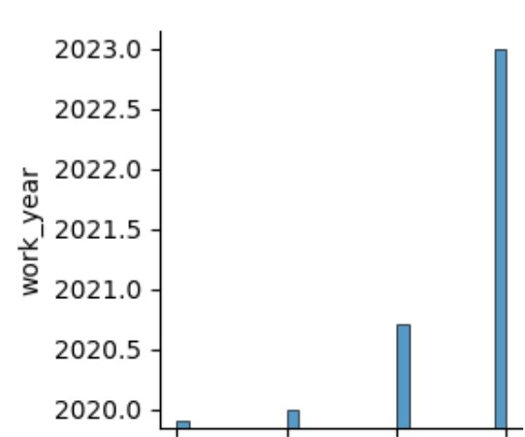
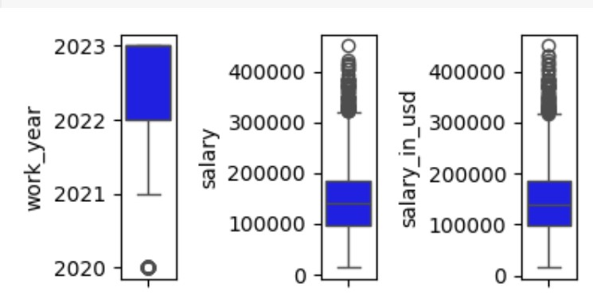
VISUALIZATION
BOXPLOT TO DETECT OUTLIER
INTERPRETATION

Slide 7
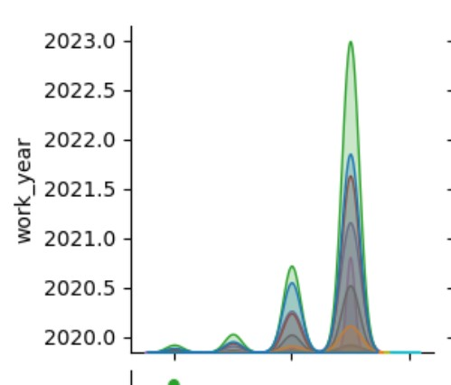
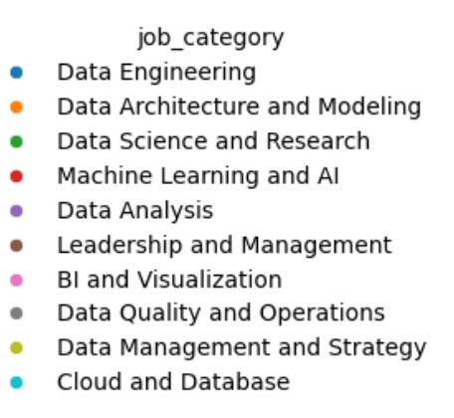
VISUALIZATION
INTERPRETATION
JOB CATEGORY

Slide 8
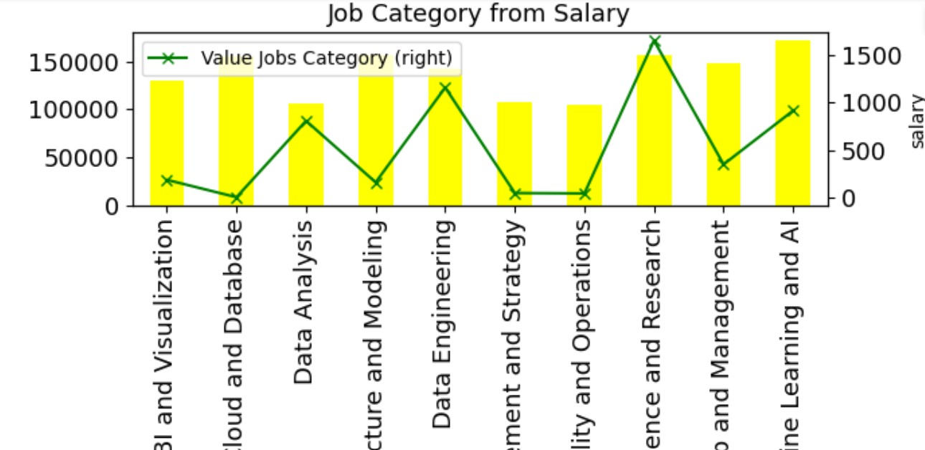
DATA ANALYST
What type of job_category is most popular with jobs in data in US and Europe?

Slide 9
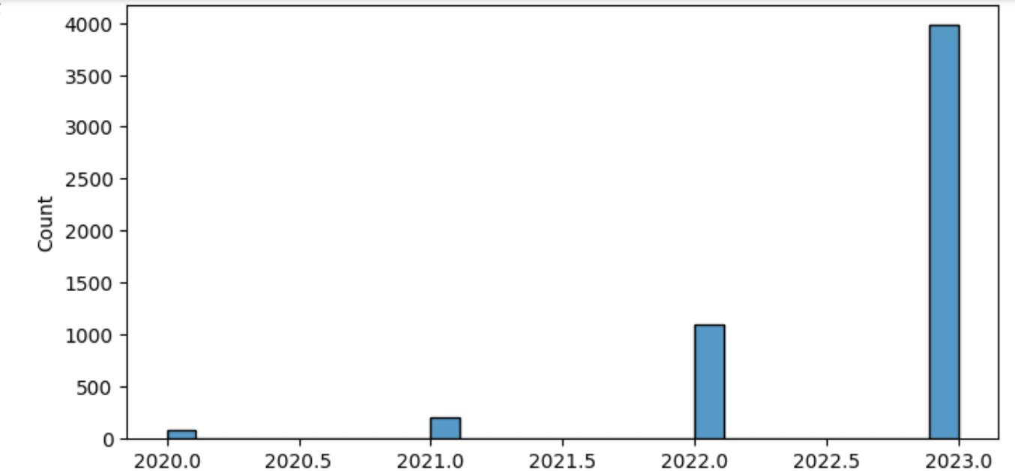
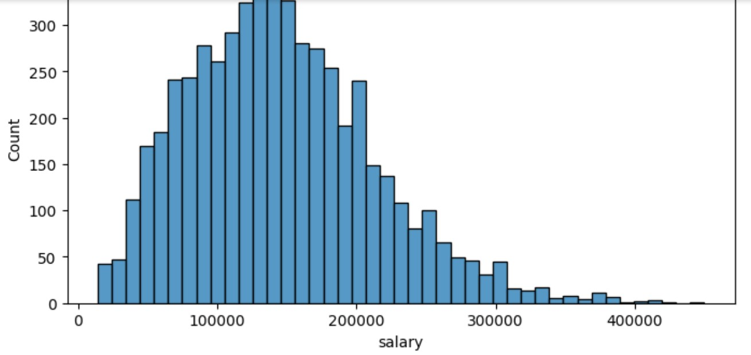
MACHINE LEARNING
CLUSTERING
CLUSTERING

Slide 10
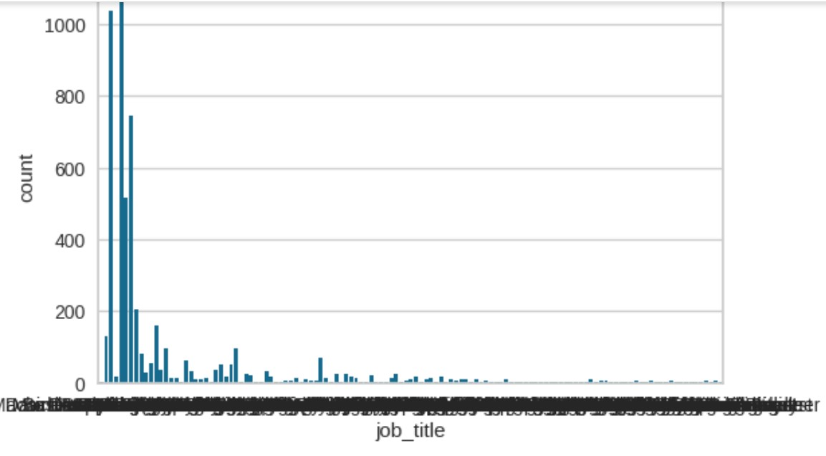
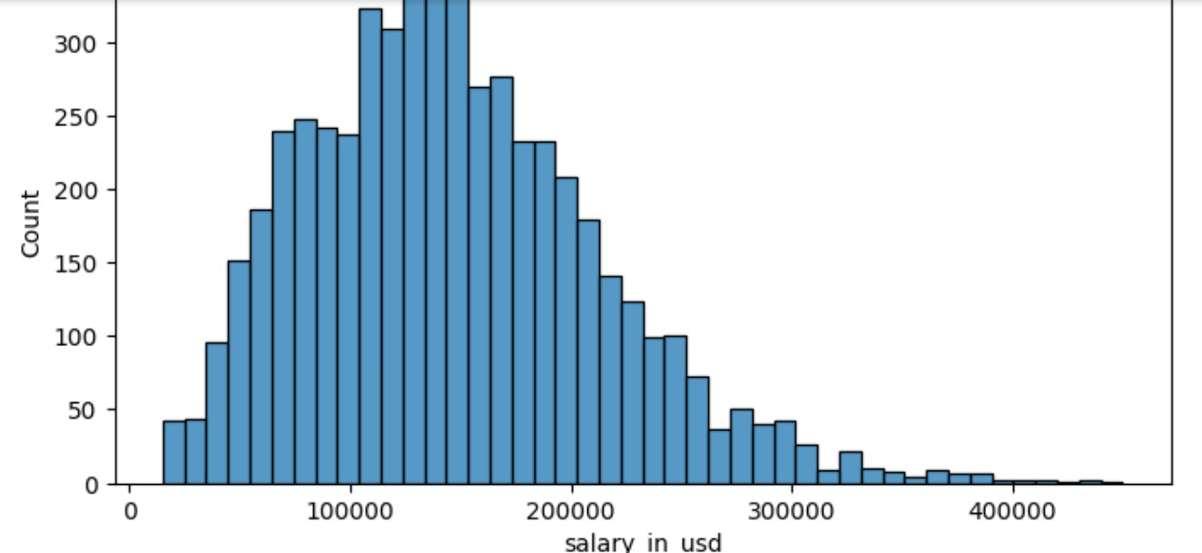
MACHINE LEARNING
CLUSTERING
CLUSTERING

Slide 11
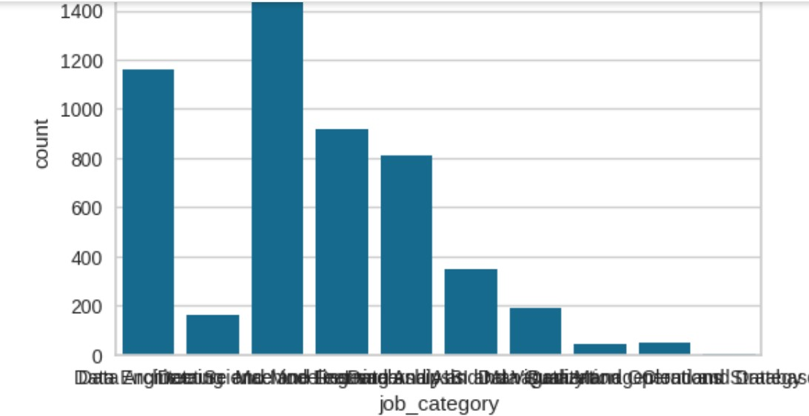
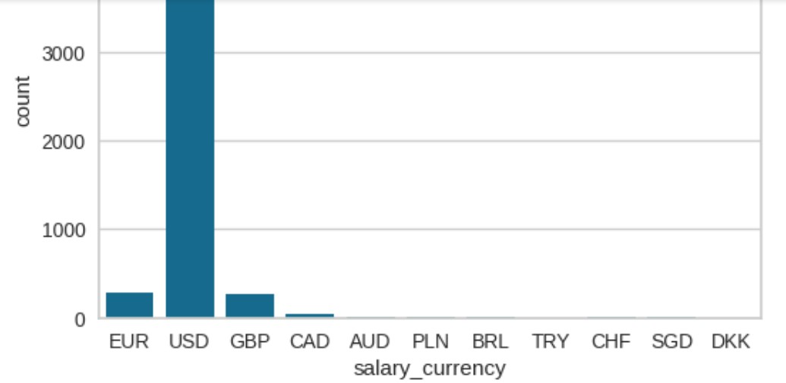
MACHINE LEARNING
CLUSTERING
CLUSTERING

Slide 12
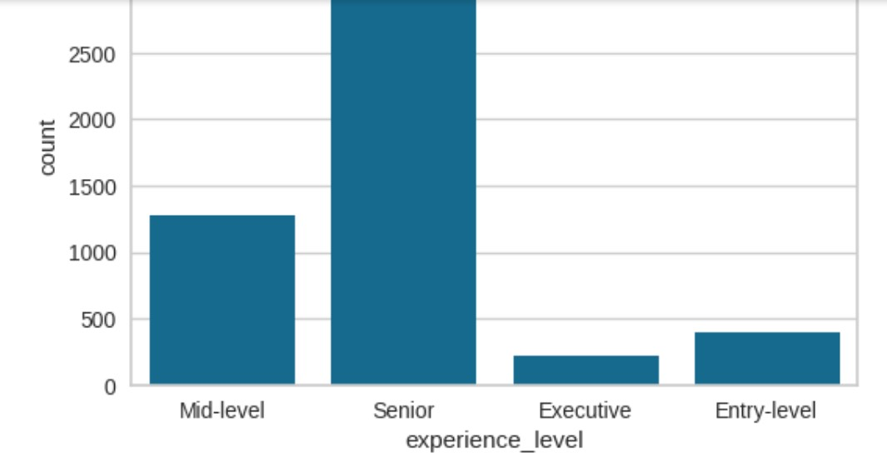
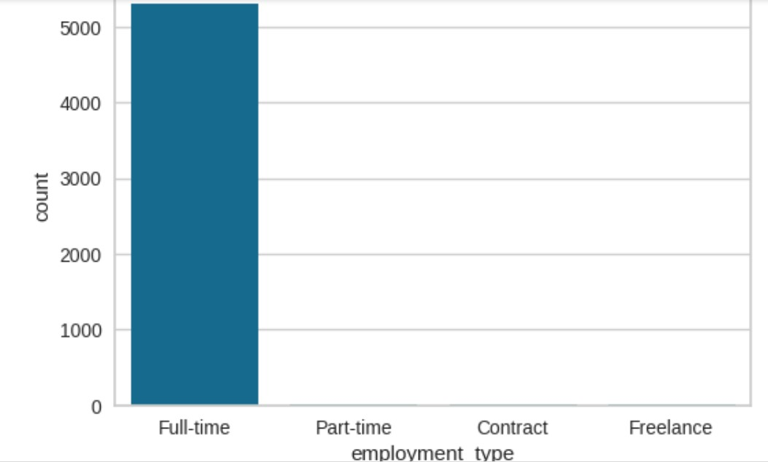
MACHINE LEARNING
CLUSTERING
CLUSTERING

Slide 13
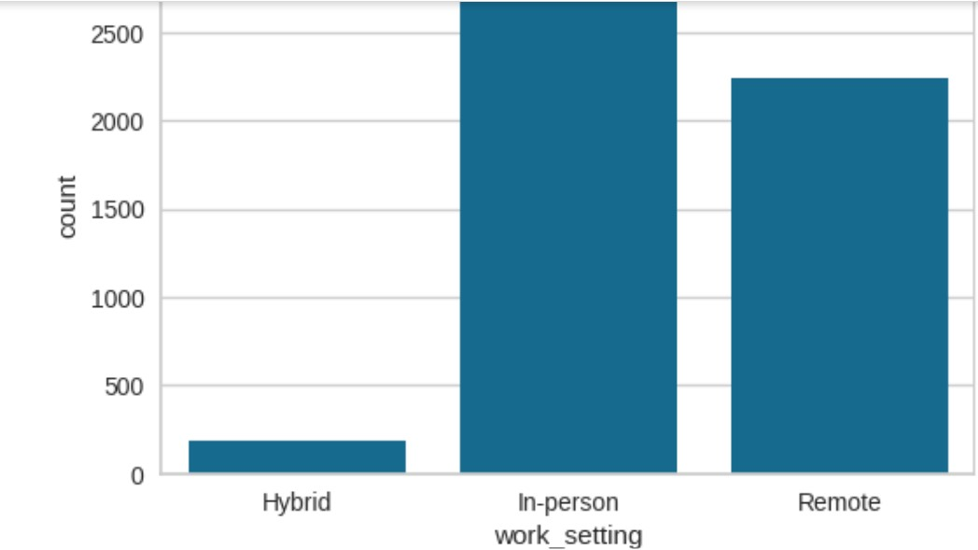
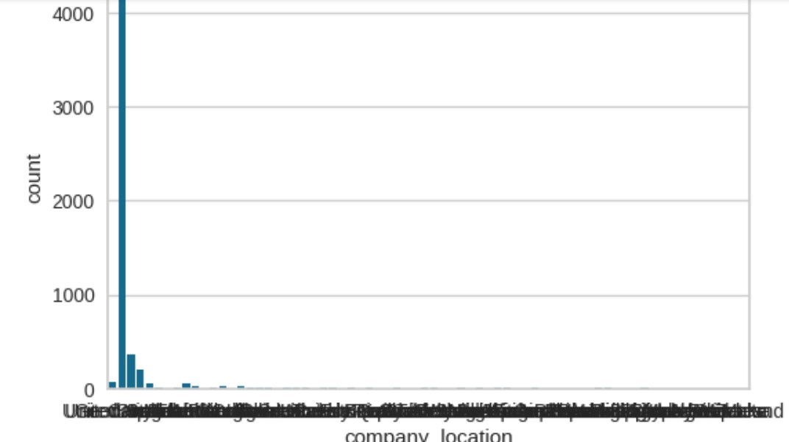
MACHINE LEARNING
CLUSTERING
CLUSTERING

Slide 14
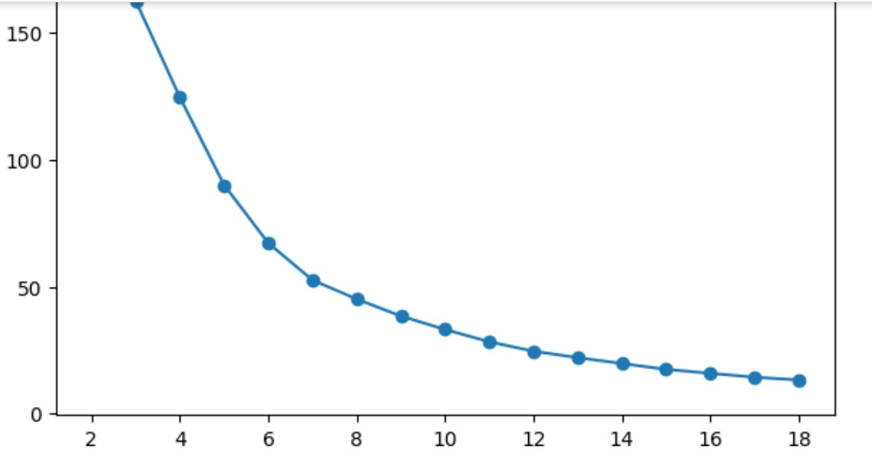
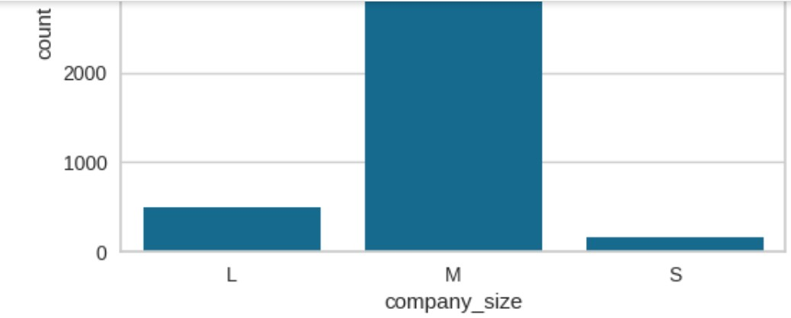
MACHINE LEARNING
CLUSTERING
CLUSTERING K-Means

Slide 15
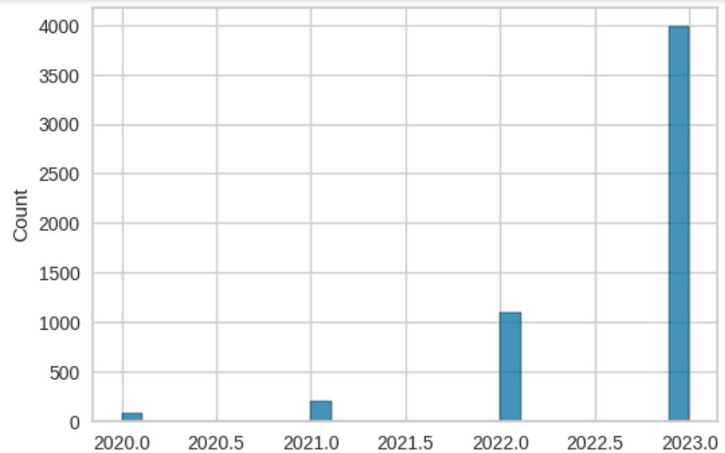
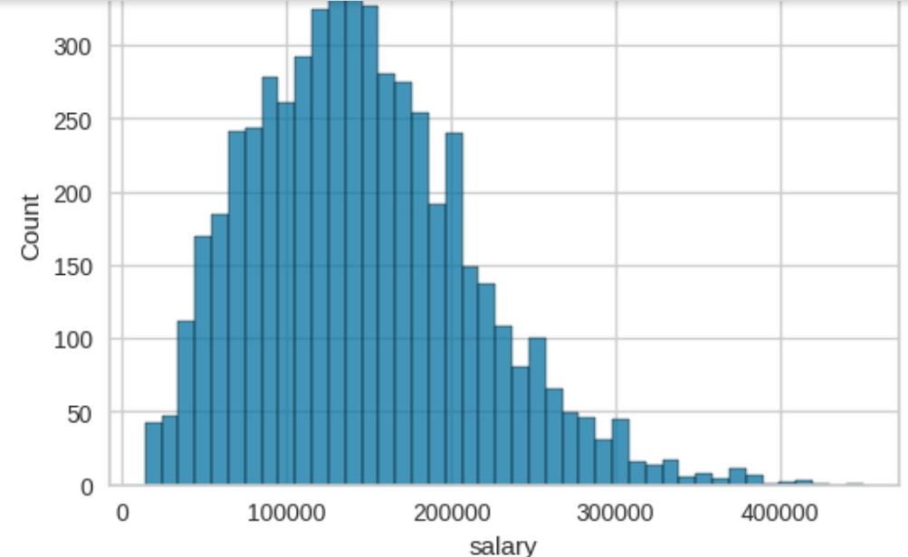
MACHINE LEARNING
CLUSTERING JOB CATEGORY
CLUSTERING JOB CATEGORY

Slide 16
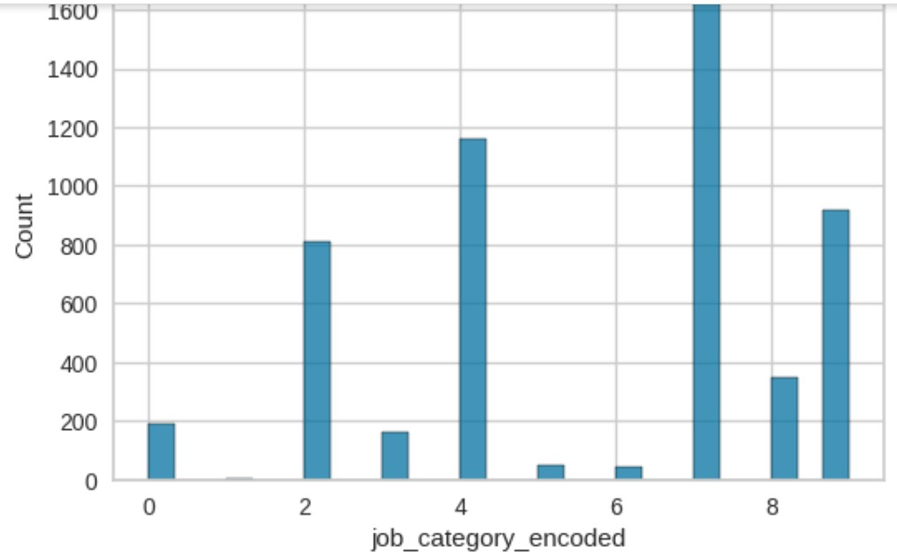
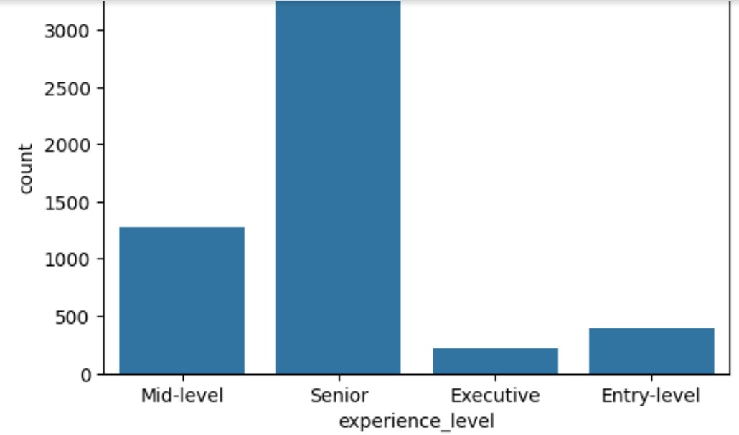
MACHINE LEARNING
CLUSTERING JOB CATEGORY
CLUSTERING JOB CATEGORY

Slide 17
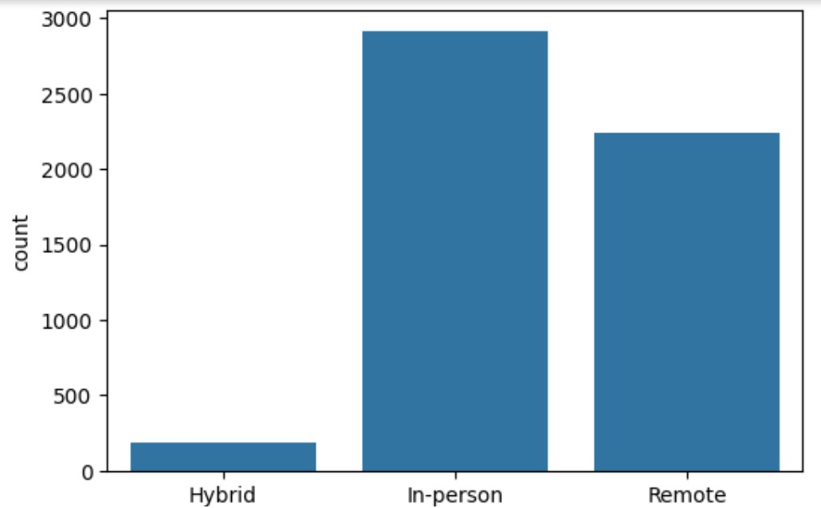
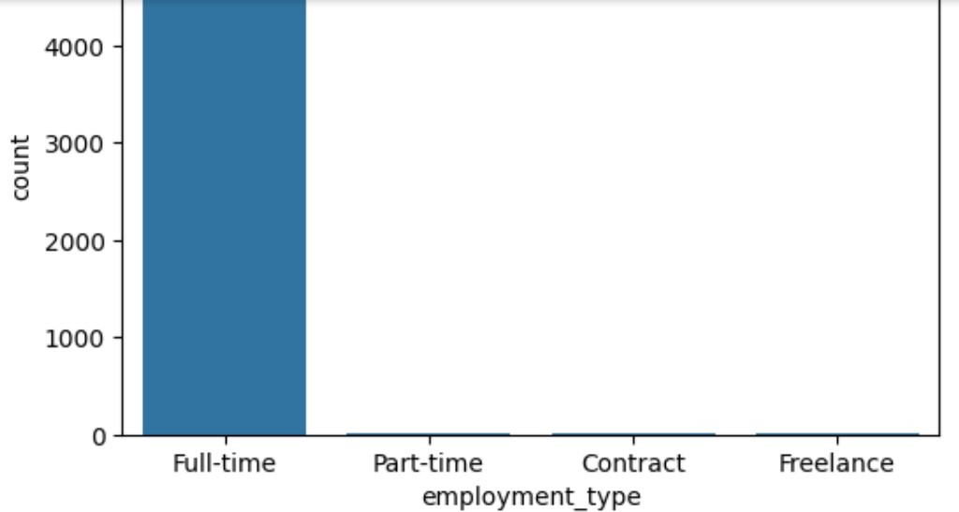
MACHINE LEARNING
CLUSTERING JOB CATEGORY
CLUSTERING JOB CATEGORY

Slide 18
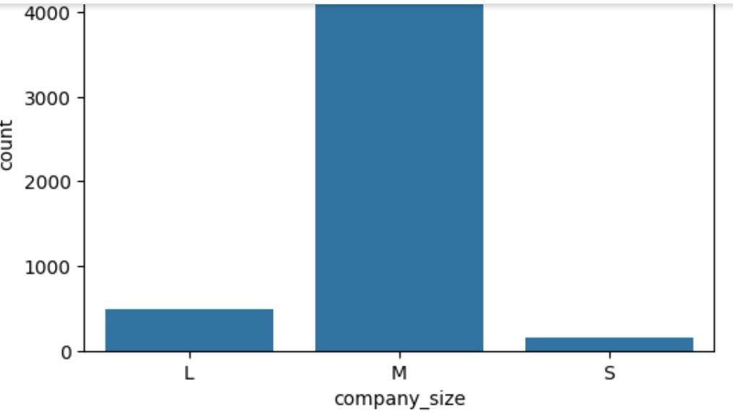
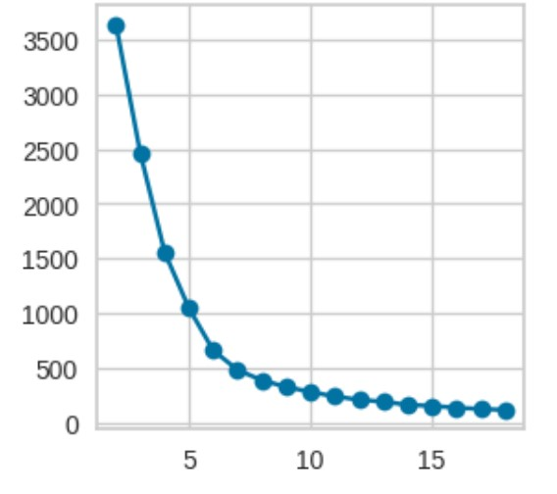
MACHINE LEARNING
CLUSTERING JOB CATEGORY
CLUSTERING JOB CATEGORY

Slide 19
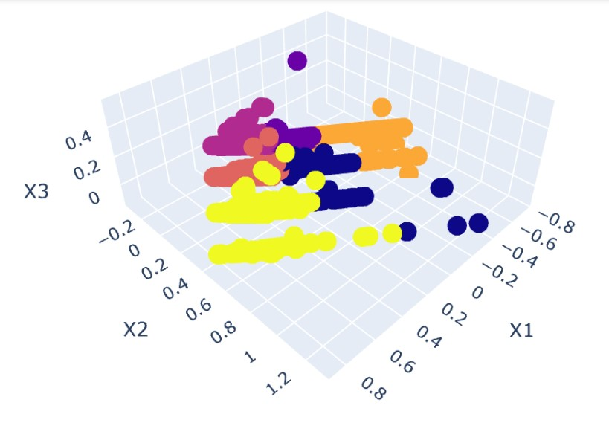
MODEL EVALUATION
Label 5 (kuning) paling dominan

Slide 20
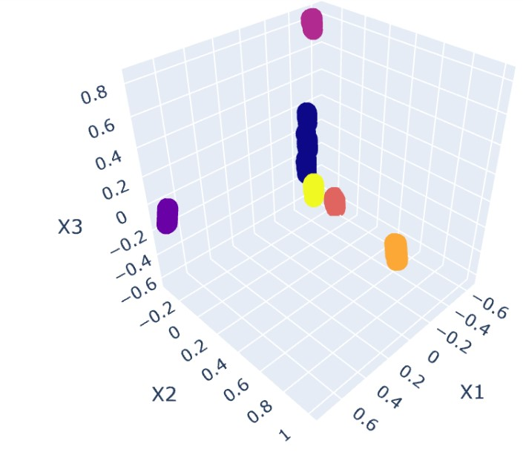
MODEL EVALUATION
Label 0 (biru) paling dominan

Slide 21
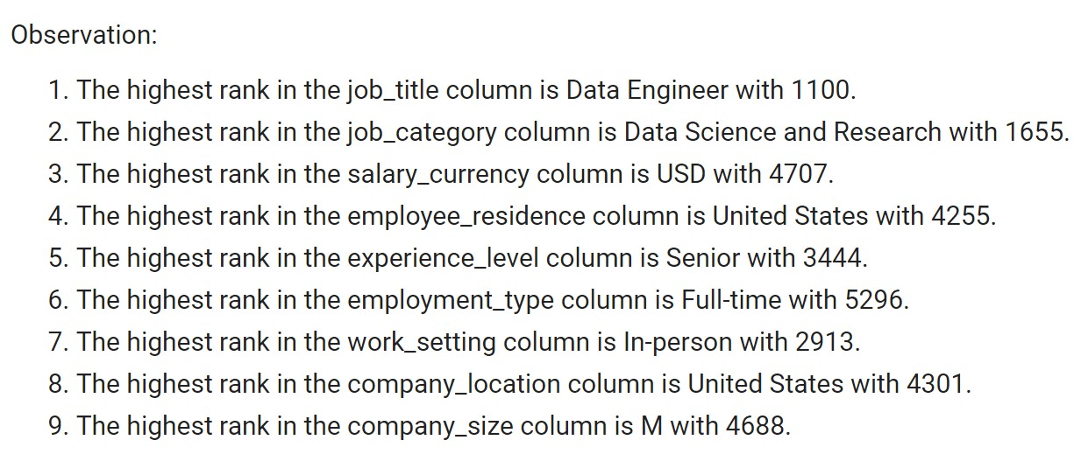
INSIGHT & RECOMMENDATION
INSIGHT

Slide 22
INSIGHT & RECOMMENDATION
RECOMMENDATION

Slide 23
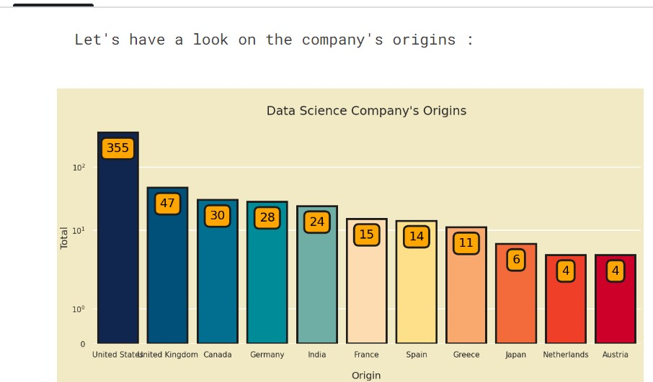
ADDITIONAL INSIGHT
ADDITIONAL INSIGHT

Slide 24
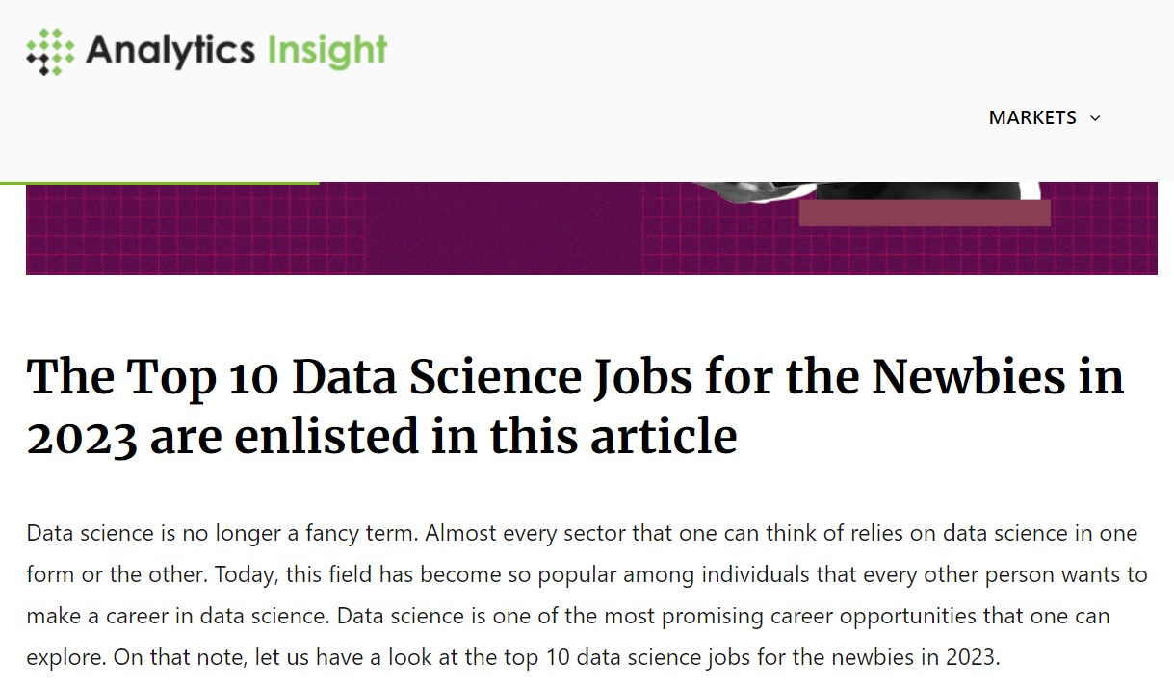
ADDITIONAL INSIGHT
ADDITIONAL INSIGHT

Slide 25
REFERENCES
https://www.kaggle.com/datasets/hummaamqaasim/jobs-in-data/data
https://www.kaggle.com/code/hasibalmuzdadid/data-science-jobs-salary-analysis-retro-vibe
https://www.analyticsinsight.net/top-10-data-science-jobs-for-the-newbies-in-2023/

